Slide 1
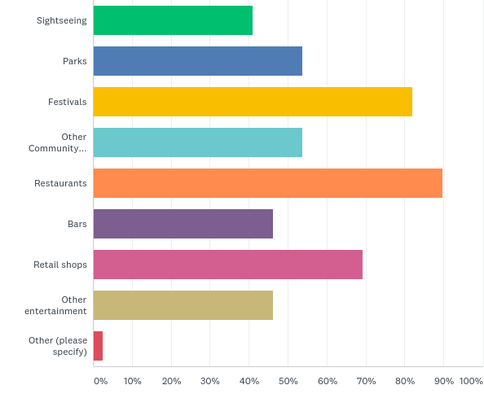
Public Survey
Fun
Notes:
The community engagement meetings brought business owners, building owners, residents, university students, and employers together to rate and suggest ideas (goals) that could be done to improve Downtown. Here are the short term goals identified through the community engagement sessions and then rated through an online survey.

Slide 2
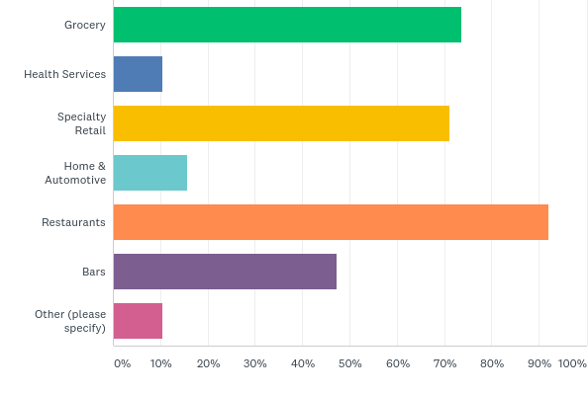
Public Survey
Businesses
Notes:
The community engagement meetings brought business owners, building owners, residents, university students, and employers together to rate and suggest ideas (goals) that could be done to improve Downtown. Here are the short term goals identified through the community engagement sessions and then rated through an online survey.

Slide 3
Evaluation Criteria
How do we measure projects and ideas
Bring more people downtown
Financial feasibility
Sustainable
Serves unmet needs
Are there people willing to lead
Does the initiative support the principles
Notes:
The community engagement meetings brought business owners, building owners, residents, university students, and employers together to rate and suggest ideas (goals) that could be done to improve Downtown. Here are the short term goals identified through the community engagement sessions and then rated through an online survey.

